Slide 1
Applying Data Science to Compare the Neighborhoods of New York and Toronto
G. G. C. M. Gunasekara
February 15, 2020

Slide 2
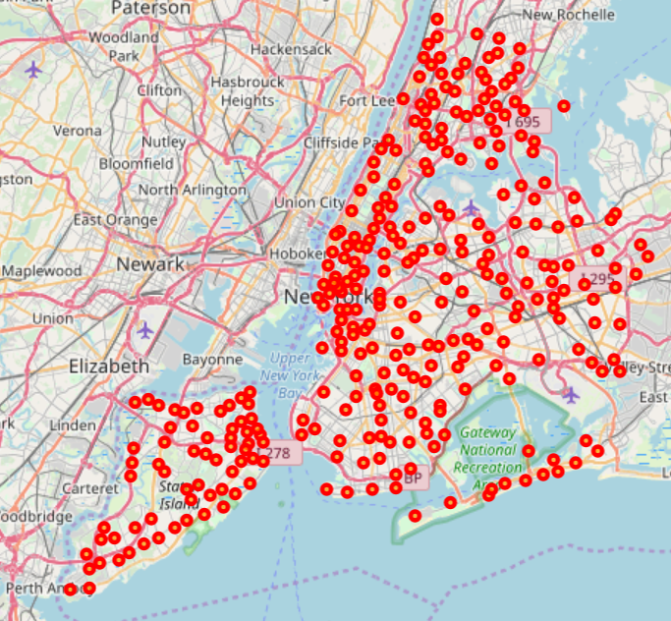
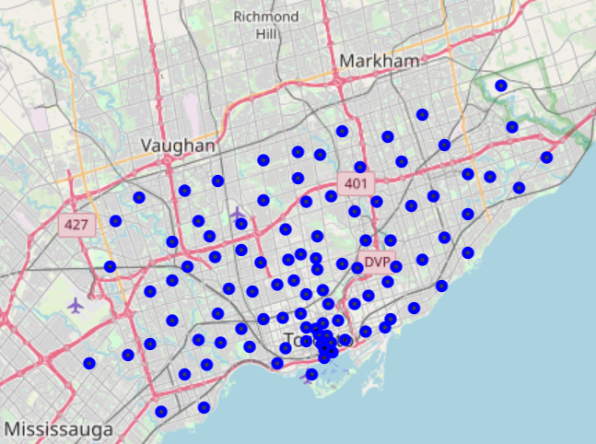
Distribution of Neighborhoods of New York and Toronto
Neighborhood of New York
Neighborhood of Toronto

Slide 3
Foursquare API used
https://api.foursquare.com/v2/venues/search?&client_id=1234&client_secret=1234&v=20180605& ll=40.89470517661,-73.84720052054902&radius=500&limit=100

Slide 4
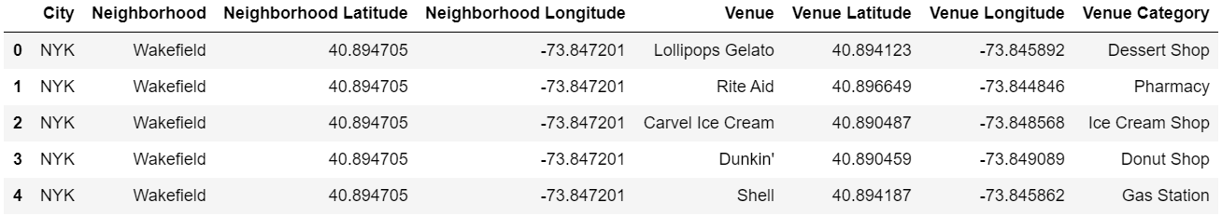
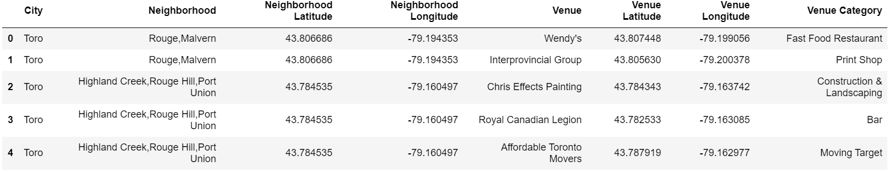
Neighborhoods with venue categories

Slide 5
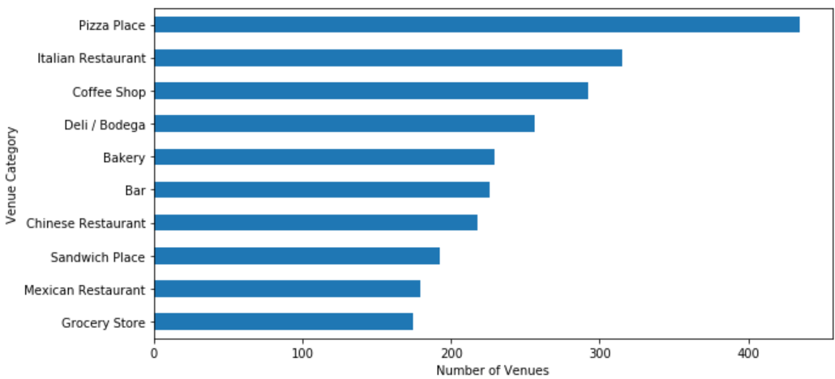
Most common venues in New York

Slide 6
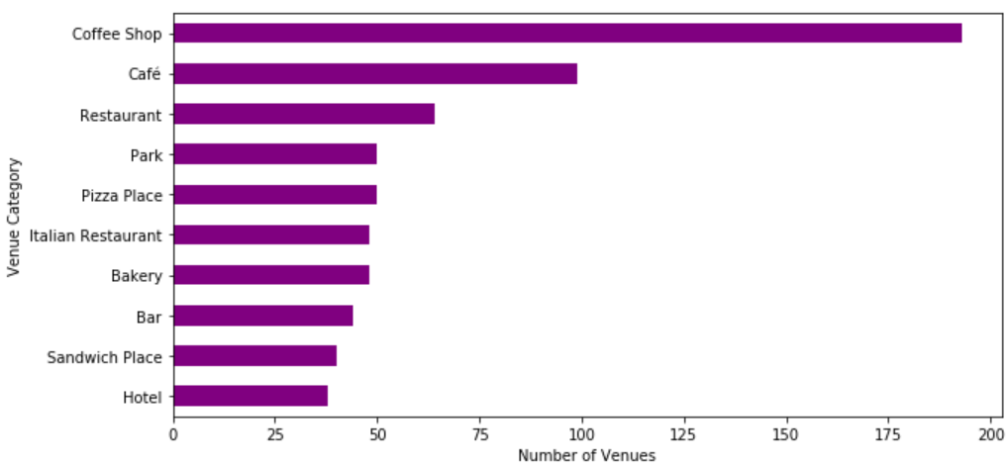
Most common venues in Toronto

Slide 7
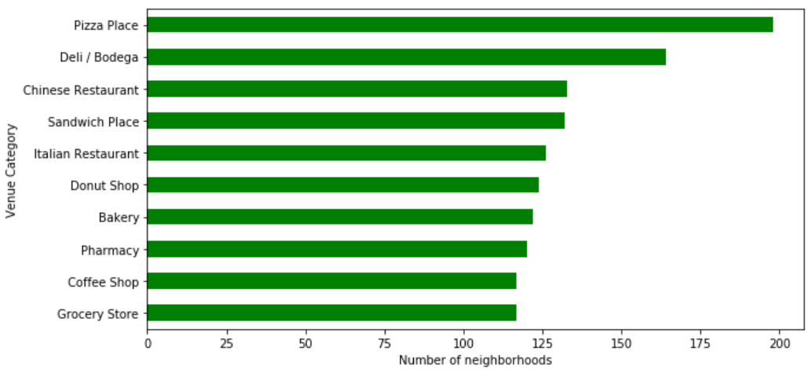
Most widespread venues in New York

Slide 8
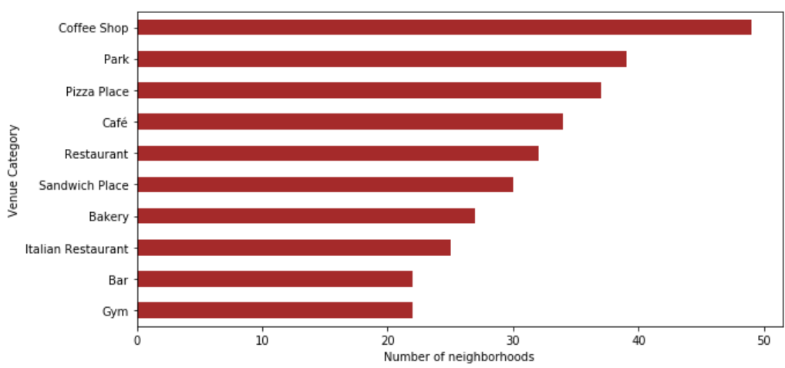
Most widespread venues in Toronto

Slide 9
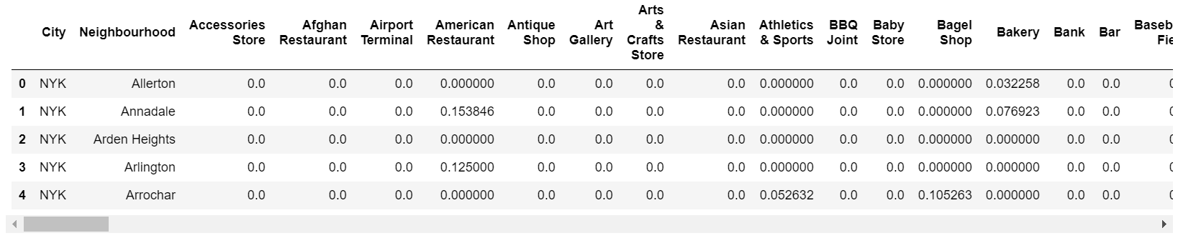
Feature Selection for clustering
The Data Frame was reformatted such that venue categories become features

Slide 10
Clustering k-means (k=5)
Distribution of neighborhoods among each cluster was as follows
 | City
Cluster Label | New York | Toronto
0 | 159 | 25
1 | 102 | 56
2 | 5 | 13
3 | --- | 3
4 | 35 | 1

Slide 11
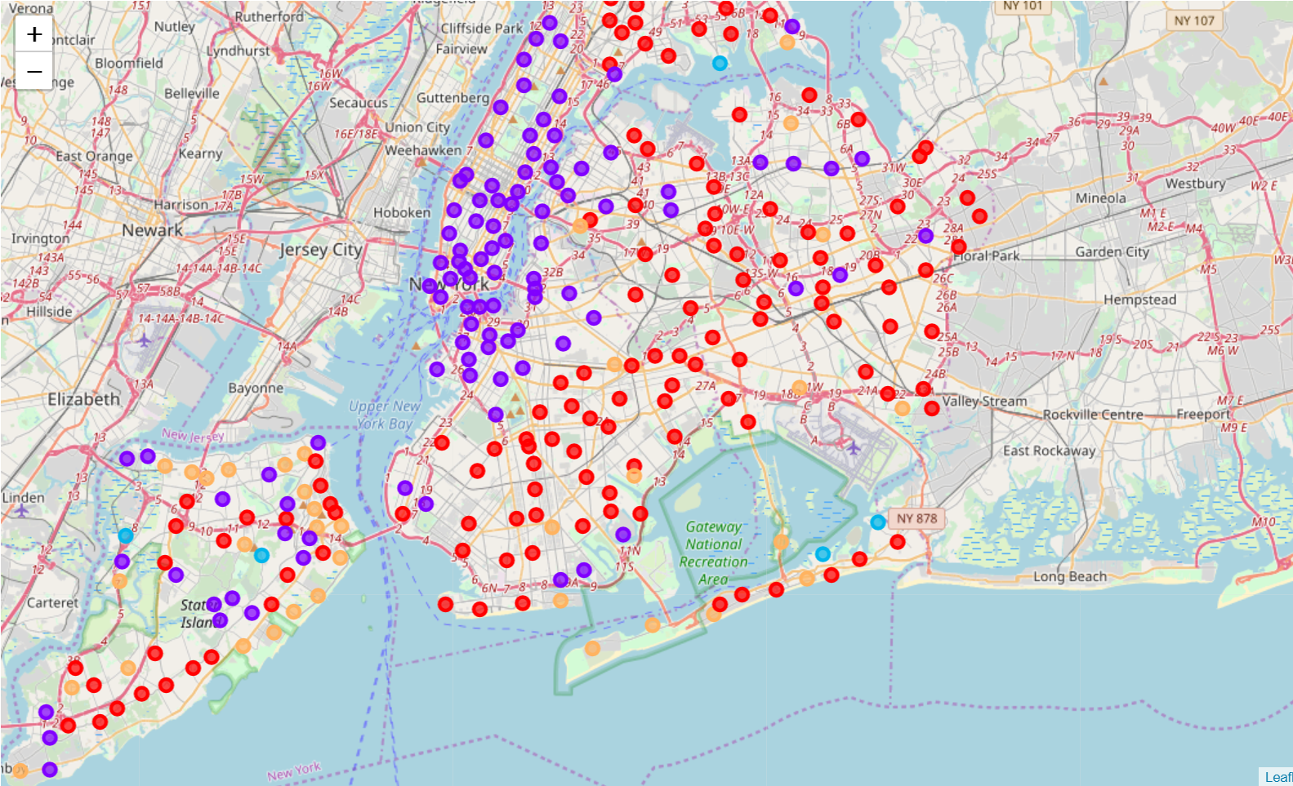
Distribution of clusters in New York

Slide 12
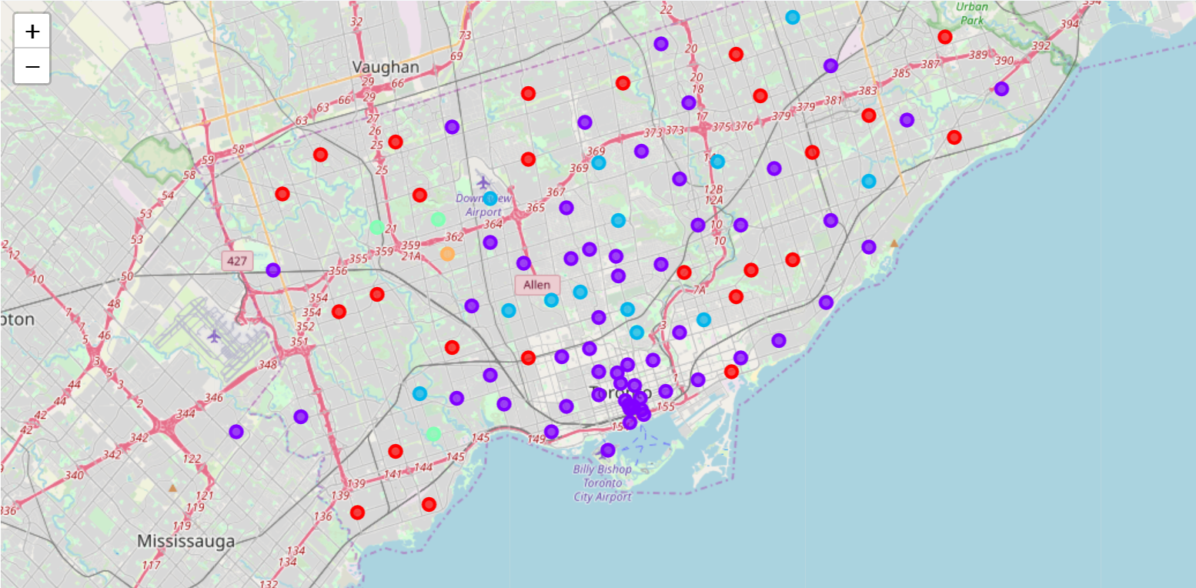
Distribution of clusters in Toronto

Slide 13
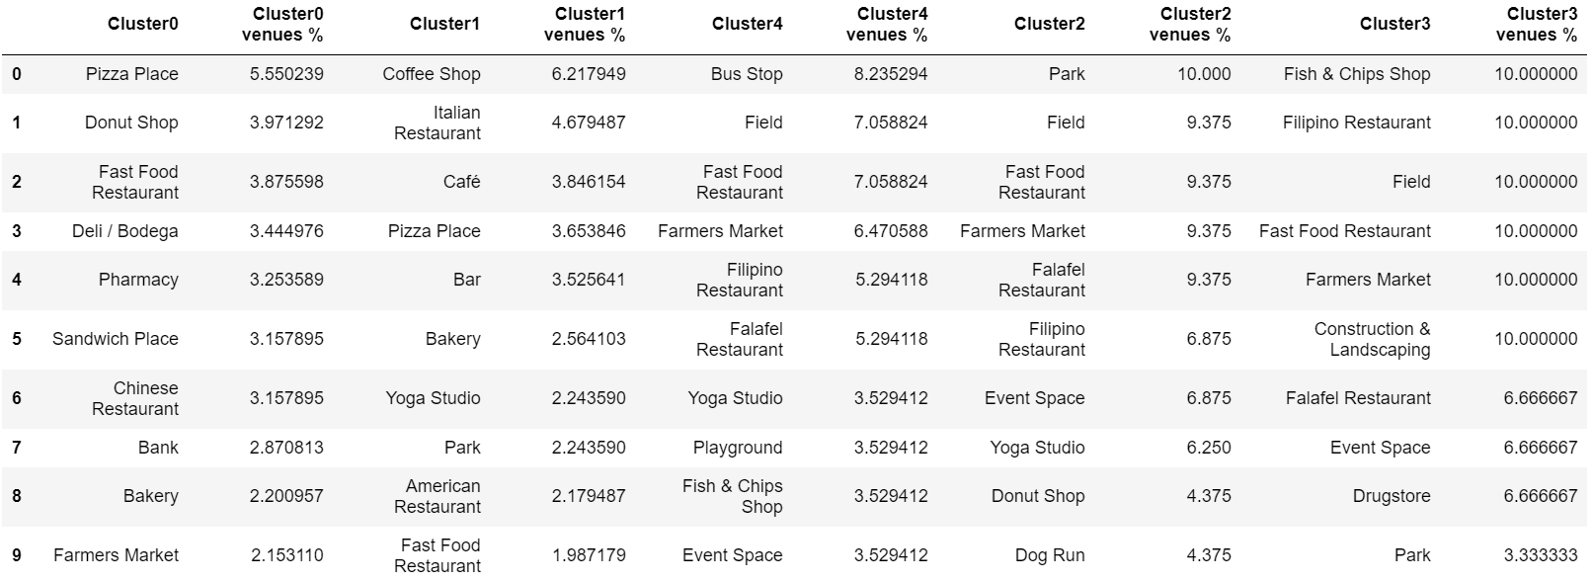
Cluster Analysis
Venues with their contribution to each cluster

Slide 14
Conclution
The difference between each cluster can be seen from the above figure. Though same venue categories are available in multiple clusters their contribution or to each cluster is significantly different. Some of the observations that can be obtained from the above figure are.
While there is a contribution of 6% from pizza places in cluster 0, there is only 3% of contribution to cluster 1 from pizza places. On the other hand, Coffee shops gives 6% contribution to cluster 1 while giving less than 2% significance to cluster 0
While Chinese Restaurants having 3% of significance in cluster 0, similar contribution is there from Italian Restaurants to Cluster 1
Pharmacies and Banks could be seen only in Cluster 0 with a significant of 3% which indicates those are more business oriented or urban places which are suitable for Business peoples and Employees
Cluster 2 which is having 9% contribution from Parks, 7% of Fast Food restaurants and 6% of Yoga studios are more suitable for leisure and relaxation.

Slide 15
Future Direction
By including other relevant information associates with venues the result could be improved better.
It is a drawback that we can’t cross check how well the clusters perform in real world

Slide 16
Thank you

